Slide 1
A glamorous introduction to text analytics for social media (Reddit)
Digital Observatory / Language Data Commons

Slide 2
Overview
Reddit
The Reddit API
AusReddit
Jupyter Notebooks
Topic models
Network graphs
Gephi
Practical stuff

Slide 3

Introduction to Reddit

Slide 4
Reddit
Social Media Platform
As of 2024 500+ million users
~138,000 active subreddits
Moderated, Unmoderated, NSFW subreddits
Forum-like in nature
Subreddit -> Submission -> Comment -> Reply
Maintains an API (for now) with public access

Slide 5
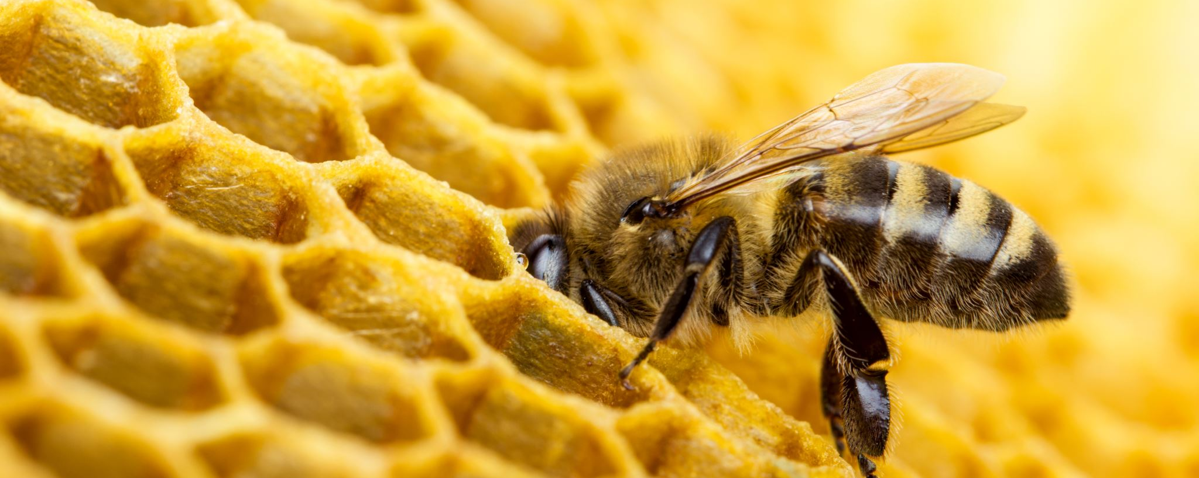
Reddit API Credentials

Slide 6
Check out the reddit wiki
https://www.reddit.com/r/reddit.com/wiki/api/
Getting an API key is quite involved unfortunately
Sign up to Reddit
Register for a researcher account (2-3 week wait time)
Build App
Get key

Slide 7
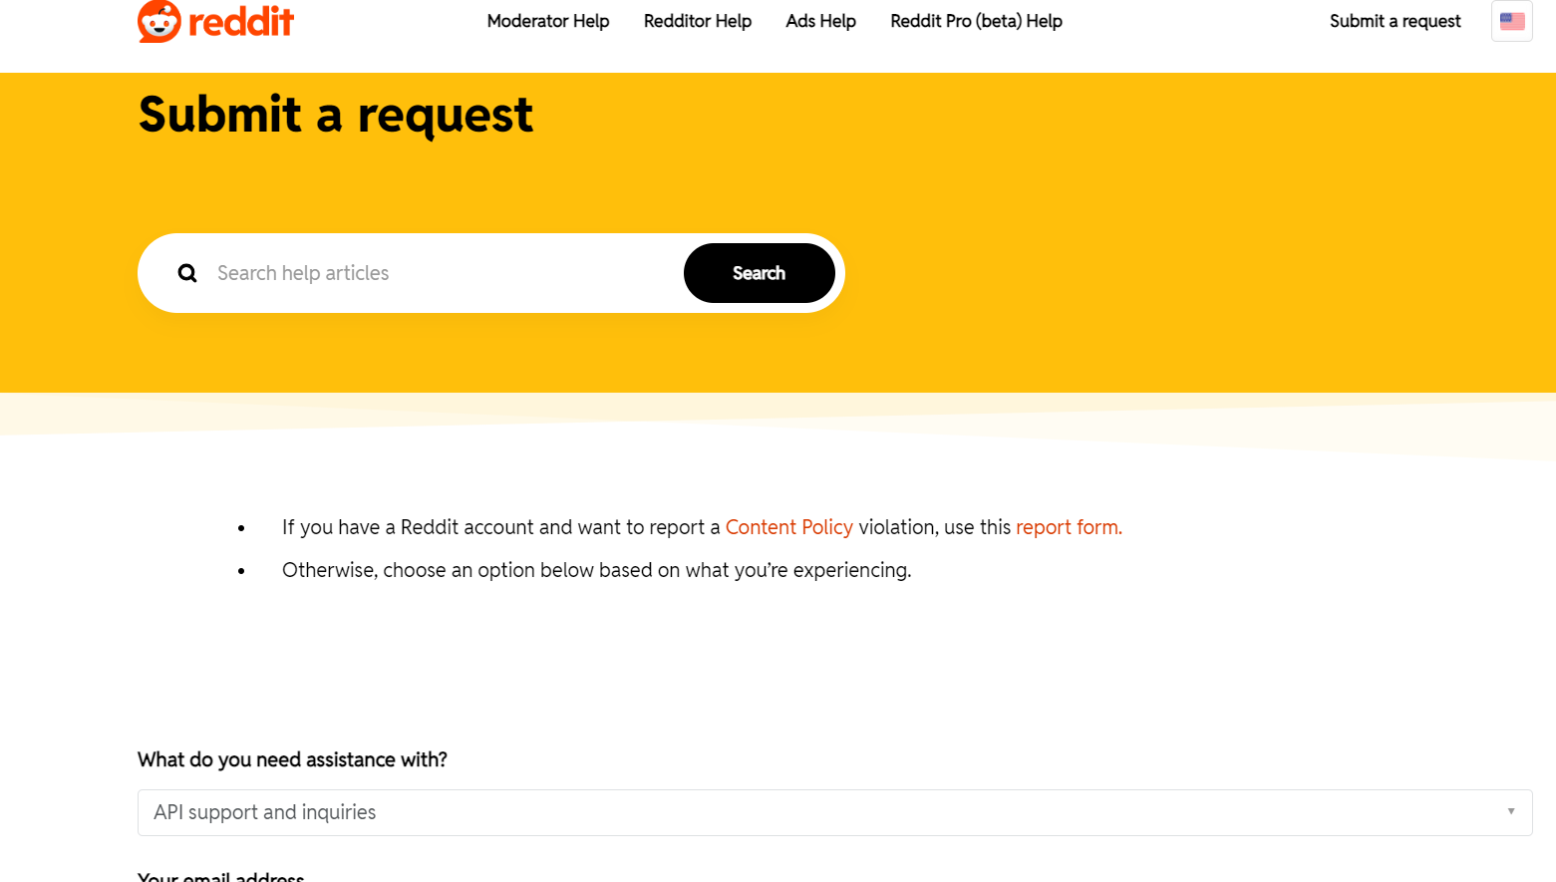
Submit a request to Reddit for API access

Slide 8
Developer versus Researcher
You can apply for a developer account with a shorter wait time
But
You may not
misrepresent or mask how or why you are accessing or using the Reddit Services and Data (including by registering multiple Apps for a single use case or substantially similar or overlapping uses cases);
create derivative works of, copy, reproduce, redistribute, rent, lease, sell, or syndicate access to features or functionality of the Reddit Services and Data;

Slide 9
User content
User Content is owned by Users and not by Reddit. You will comply with any requirements or restrictions imposed on usage of User Content by their respective owners, which may include “all rights reserved” notices, Creative Commons licenses, or other terms and conditions that may be agreed upon between you and the owners. Except for the Reddit License, no other rights or licenses are granted or implied, including any right to use User Content for other purposes, such as for training a machine learning or artificial intelligence model, without the express permission of rightsholders in the applicable User Content.
You agree to provide attribution of User Content in your App by providing a link back to the User Content on our Services, cite the applicable User’s username, and clearly indicate that the User Content is from our Services in accordance with our Brand Guidelines and Press Guidelines.

Slide 10
Ethics
What reddit does not have is a transparent researcher terms and service agreement.
This is likely to cause issues with ethical use of the platform if you apply for developer access
As the attribution clause highlighted conflicts with any ethical need to de-identify or anonymise data
Basically, we live in an uncertain time for Reddit

Slide 11
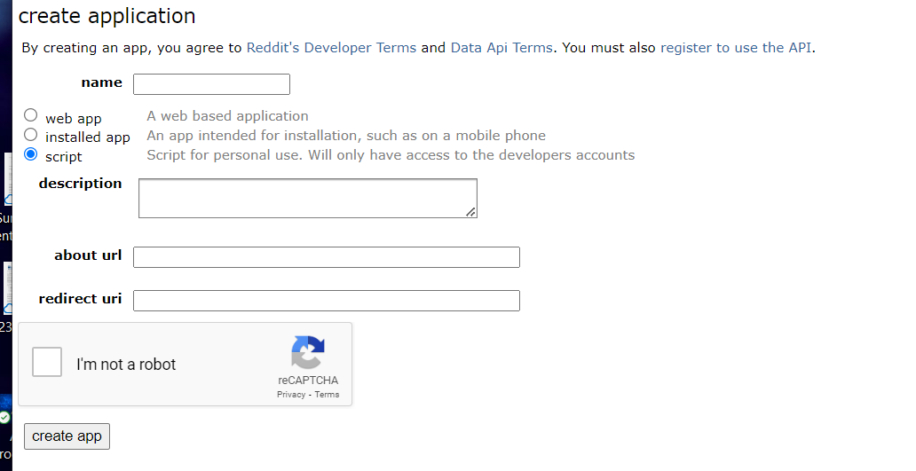
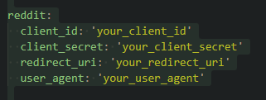
Getting Reddit API credentials
https://old.reddit.com/prefs/apps/

Slide 12

AusReddit

Slide 13
AusReddit
Hand curated Australian related subreddits from Reddit
2005 -> current (well last month)
~600 subreddits
~100 million posts
You need an API key
You can apply to the DO for one

Slide 14

Introduction to Notebooks

Slide 15
Jupyter iPython Notebooks
Interactive notebooks
Can run Python or R code
Made up of cells which can contain code or text
Cells can be run one at a time or all together in sequence
[*] – means the cell is being run
[1] – means the cell has run and is the first cell run in sequence – the number changes for each cell run [1] -> [n]
Output appears under the run cell
You do not need to fully understand the code that runs in the cell for this workshop

Slide 16

Introduction to Topic Modelling

Slide 17
Topic modelling
Topic modelling is a computational way of discovering what topics are contained within a set of documents
They work by “clustering” bag-of-words together to form a topic
The bag-of-words are words which occur together more often than at random
These bag-of-words represent a topic – things that are being talked about
This is different to what a human may think a topic is but can be a useful indicator of what is being discussed
There are many different ways to make a topic model
Ideally you need more than a few hundred documents (1000+ is better)

Slide 18
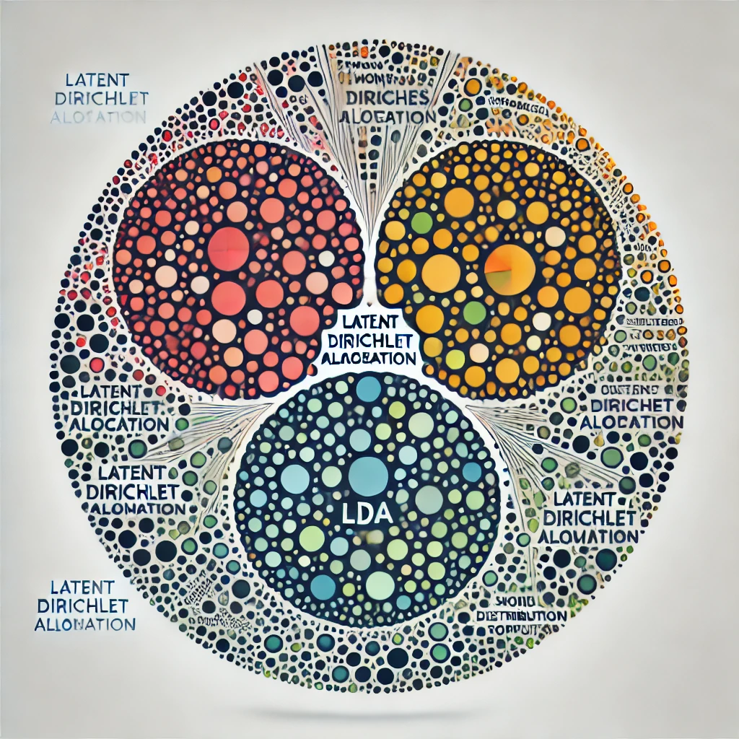
LDA
Latent Dirichlet Allocation
Uses word association and probability
Not context aware
Useful in discovering unobserved topics
Does need a K value
Can be run on CPU
This is the model we will run

Slide 19
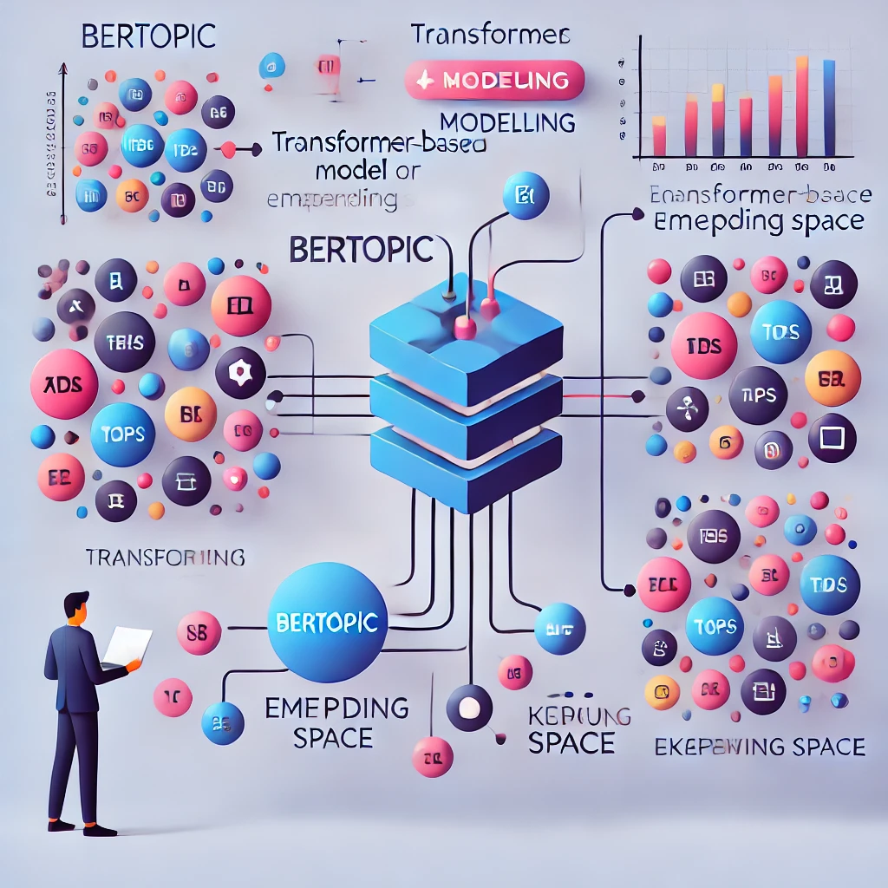
BERTopic
A more complex model than a bag-of-words to make the representations
Based on word embeddings
Somewhat context aware
hierarchical clustering
Does not need a K value
Optimally uses a GPU to accelerate the process

Slide 20
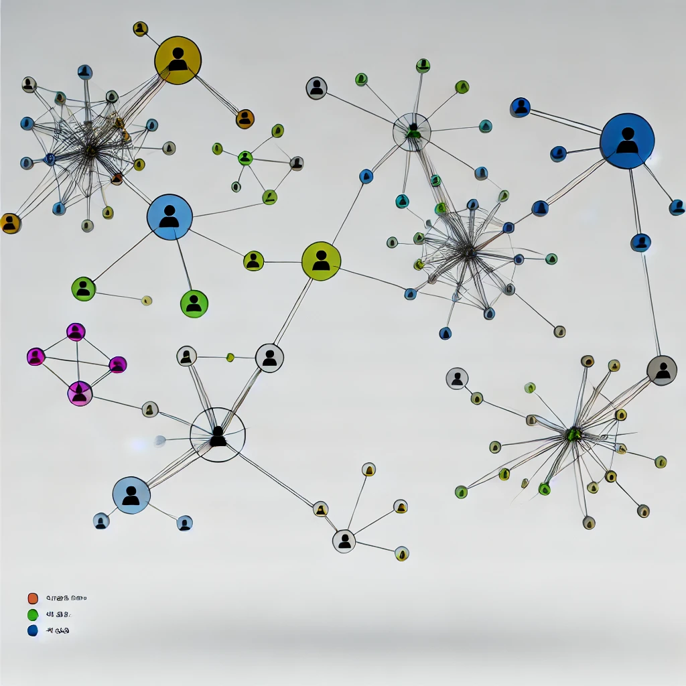
Introduction to Network Graphs

Slide 21
Network Graphs
Represent the relationship between entities
Nodes – the points on the graph, these can represent any type of entity – people, documents, agents, artifacts
Edges – the links in the graph, these represent the relationship between the nodes. These may be directed or undirected and can contain information about nature of the link.
We are going to use nodes to represent submissions and comments.
We are going to use edges to indicate a reply-to relationship. Directed from parent comment to reply comment.
We are also going to add node properties to indicate topic etc

Slide 22
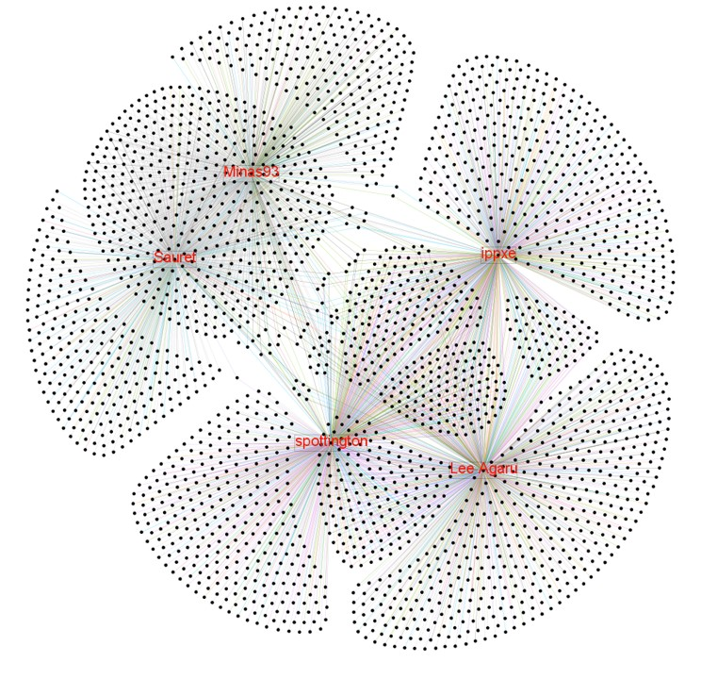
Gephi

Slide 23
Graph visualisation
Visualising graphs in Python or R can be quite tricky (not impossible)
Instead, we can use open-source tools which offer more functionality
One of these tools is Gephi
https://gephi.org/

Slide 24

Let’s go to the Binderhub environment

